Slide 1
Group Dynamics and Team

Slide 2
Group
Group
Two or more people who interact with each other to accomplish certain goals or meet certain needs.
Meaning of Group
Two or more individuals who
Share a set of norms, values or beliefs
Have certain role relationships
Experience interdependent behavior
A social system in which members
Have regular contact
Act cooperatively
Share common goals

Slide 3
Team
A group whose members work intensely with each other to achieve a specific, common goal or objective.
All teams are groups but not all groups are teams.
Teams often are difficult to form.
It takes time for members to learn how to work together.

Slide 4
Importance of Groups/ Teams for Organization
Synergy = the creation of a whole that is greater than the sum of its parts
Superior performance (i.e., better than lone individuals) when:
Problem-solving can be handled by dividing work and sharing information
Need for creativity and innovation (groups more willing to take risks than are individuals)
Forum to learn and share information

Slide 5
Differences between a Group and a Team
Group | Team
Strong, clearly focused leader | Shared Leadership Roles
Individual accountability | Individual and mutual accountability
Individual work products | Collective Work Products
Leader runs efficient meetings that report progress | Leader encourages open-ended discussion and active problem-solving meetings
Discusses, decides and delegates | Does real work together
1 Adapted from “The Disciple of Teams” by J.R. Katzenbach and D.K. Smith. Published in Harvard Business Review, March-April 1993, pp.111-120

Slide 6
Change of Expectations for a Team
“Loyalty” is redefined from “agreeing with the boss” to “achieving the larger goals”
Decisions are not made in isolation and handed down. The team jointly solves problems, collaborating on the preferred solution

Slide 7
Group Dynamics
The social process by which people interact and behave in a group environment is called group dynamics.
Group dynamics involves the influence of personality, power, and behavior on the group process.
Types of Groups
Formal Group
Structured to pursue a specific task
Informal Group
Emerge naturally

Slide 8
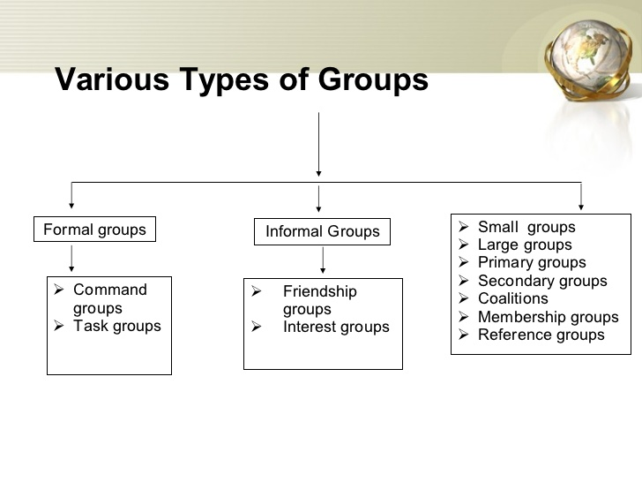
Group

Slide 9
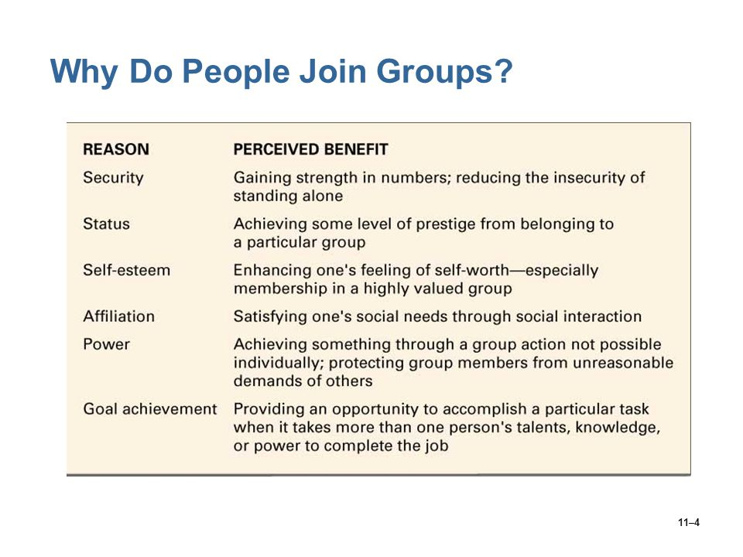

Slide 10
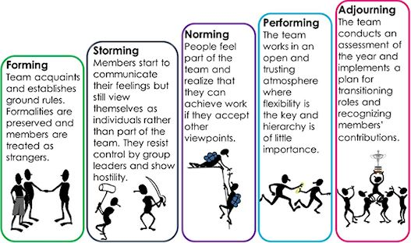
How Groups are Formed?

Slide 11
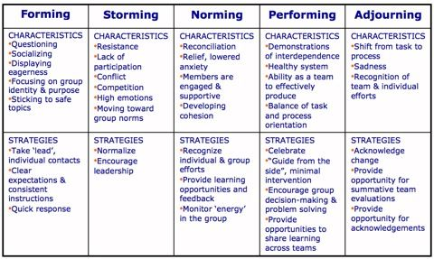

Slide 12
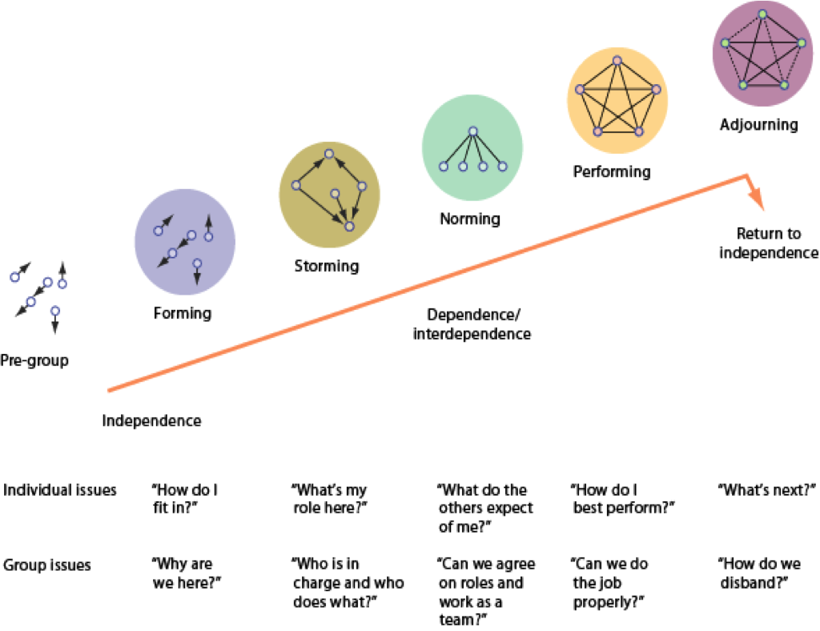

Slide 13
Group Dynamics

Slide 14
Roles: The Hats We Wear
Role Incumbent: A person holding a particular role
Role Expectations
Role Ambiguity
Role Differentiation
Task oriented
Socio-emotional
Self-oriented
Norms: A group’s unspoken rule
Prescriptive vs. Proscriptive norms
“Don’t steal pebbles” says “Most people leave the pebbles to preserve the natural integrity of the forest.”

Slide 15
Status
Formal Status
Status Symbol
Informal Status
Cohesiveness
Individual Performance in Groups
Social Facilitation
Social Loafing

Slide 16
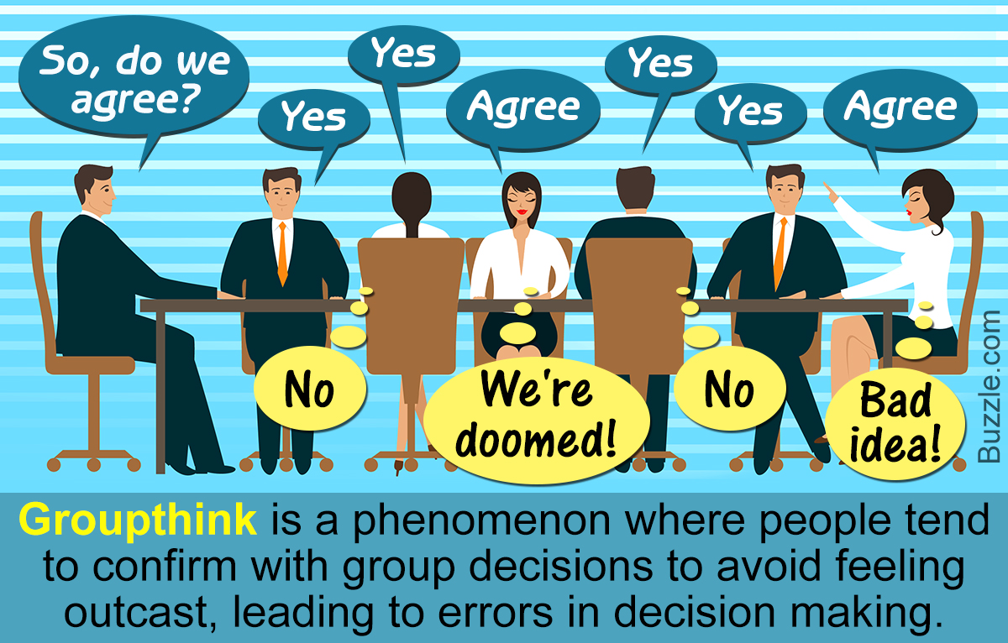
How Groups can Intensify Decisions?
Group Think:
A tendency by group members to suppress dissenting opinions in the interest of group harmony, which can sometimes lead to disastrous (or unwise) decisions.
Groupthink is most likely in centrally directed groups which view themselves as a highly cohesive unit.

Slide 17
Group think: Symptoms
Overestimation of the in-group (as strong, smart, invulnerable, morally superior)
Negative stereotyping regarding the outgroup (as weak, immoral, vulnerable, stupid, and wrong)
Close-mindedness (e.g. rationalization of doubt)
Pressures for uniformity (via mind guards, self censorship, illusion of unanimity)

Slide 18
These symptoms, in turn lead to a number of defective decision-making processes.
inadequate contingency plans for failure,
b) inadequate information search,
c) biased assessment of risks, costs, benefits and moral implications (e.g. inadequate consideration of worst case scenarios),
d)incomplete consideration of the full range of decision options and
e) failure to reconsider the extent to which original/fundamental objectives were served by the advocated action

Slide 19
Group Polarization
The tendency of people to make decisions that are more extreme when they are in a group, as opposed to a decision made alone or independently.
Strengthening of pro/ anti sentiments after following a group discussion.

Slide 20
Self Assessment Time: Belbin team role
To complete each section of this inventory, tick in the far left hand column the one, two or three sentences most applicable to yourself.
Then in the column on the right, apportion 10 points between those sentences that apply to you: one of which you feel sums you up well while the other only applies some of the time. In this instance you could give your first choice seven points and the remaining points to your second choice. In some instances you might decide that there are two sentences which apply to you equally - if this is the case, award five points to each.
You must allocate all 10 points in each section.

Slide 21
SECTION A
WHEN INVOLVED IN A PROJECT WITH OTHER PEOPLE:
Tick |  | Points
 | I can be relied upon to see that work that needs to be done is organized.
 | I pick up slips and omissions that others fail to notice.
 | I react strongly when meetings look like losing track of the main objective.
 | I produce original suggestions.
 | I analyse other people’s ideas objectively, for both merits and failings.
 | I am keen to find out the latest ideas and developments.
 | I have an aptitude for organising people.
 | I am always ready to support good suggestions that help to resolve a problem.

Slide 22
Team Constitution
“Working in science and technology is intellectually demanding. Such teams, to be most effective, should therefore be composed of high IQ individuals”
True or false? Why?
Nobody is perfect.
Challenge: How to build a perfect team out of imperfect people?

Slide 23
Perfect individual could be described as:
Outgoing Organised Motivating Creative Hardworking Hard driving Objective Diplomatic Meticulous Knowledgeable
Unlikely to find all these qualities in an individual
Belbin: Apollo Syndrome
What makes successful team?
Successful teams contain members with different key attributes and are not collections of ‘Similar’ people

Slide 24
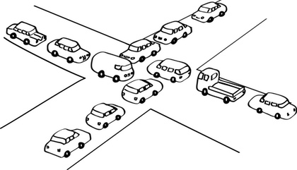
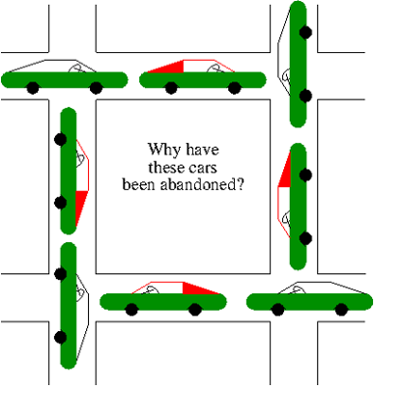
Apollo Syndrome
Bad performance by Teams of highly capable individuals
The deadly Embrace/ Deadlocks

Slide 25
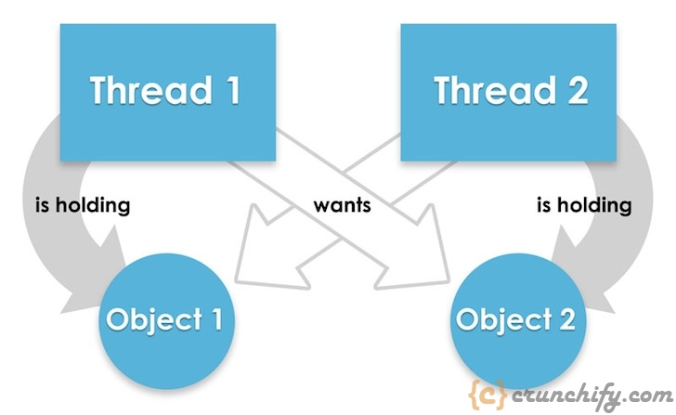
A set of processes is deadlocked if each process in the set is waiting for an event that only another process
in the set can cause, thus, no process can
run
release resources
be awakened

Slide 26
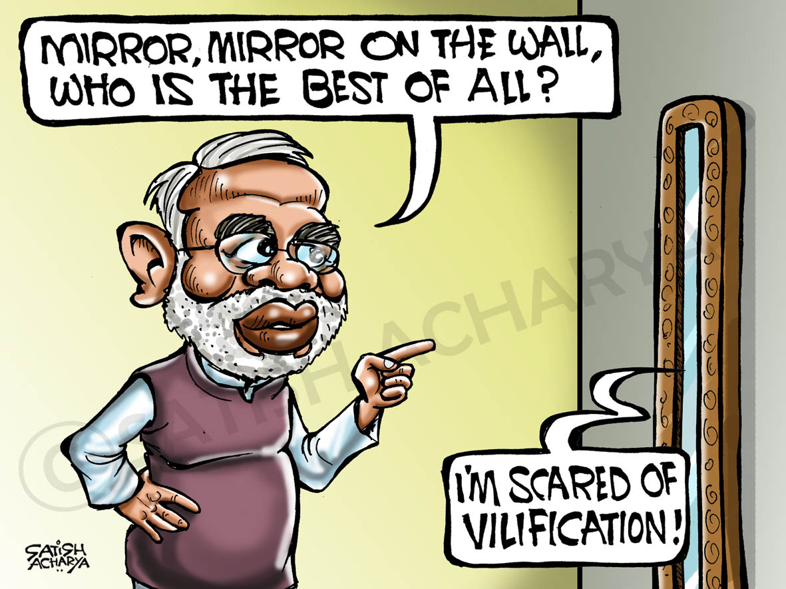

Slide 27
What Happens in a deadlock?
People dig into their own preferred solutions
Operate from a unilateral control mindset
Values of the Unilateral Control Mindset
Win, don’t lose
Be right
Minimize expression of negative feelings
Act rational
How deadlocks develop
Connect the dots puzzle
Dots: Assumptions, Interests, and Relevant Information
Line connecting the dots: Reasoning process

Slide 28
Incoherence in agreed decision
Lack of collaboration: Tendency to act along favorite lines
In some instances, teams recognized what was happening but over compensated - they avoided confrontation, which equally led to problems in decision making.

Slide 29
Apollo syndrome version 2:
It describes the condition where someone has an overly important view of their role within a team.
'Double Apollo'
A team is composed of highly capable people, that achieves little, but claims great success

Slide 30
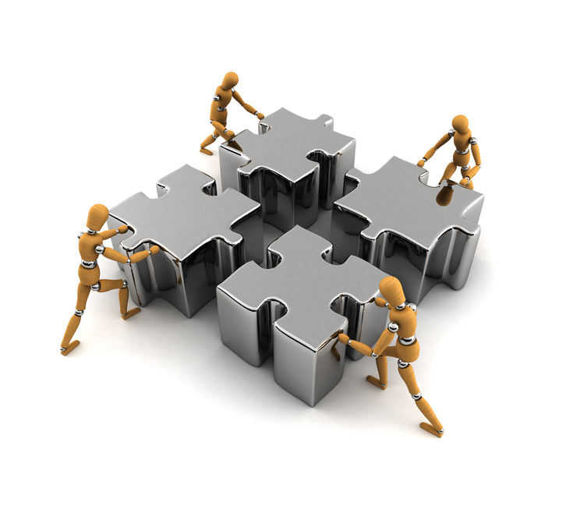
What is a Team Role?
A tendency to behave, contribute, and interrelate with others in a particular way --when working in a team
Belbin’s research found that when all 9 “areas of contribution” – or team roles were covered (and balanced), that team had a higher predictability for success and high-performance.
(versus a “Functional Role,” which refers to the job demands that a person has to meet by supplying the requisite technical skills and operational knowledge)
Notes:
So the official of a Team Role, is the tendency to behave, contribute and interrelate with others in a particular way.

Slide 31
Team Roles
Nine Roles Identified
The team roles fall into three categories for each person:
Natural or Preferred roles
Manageable roles they can assume
Least Preferred roles
As individuals differ greatly in personality & behavior, so too will their team role compositions vary.
Notes:
So Belbin identified 9 Team Roles and that they fall into 3 catagories: Preferred Roles – most natural and easiest to do), Manageable Roles that are not quite as easy for us, be we can do it if required and Least Preferred roles – those areas that we really struggle with – we don’t enjoy doing it.
Most people have 3 roles that are Preferred; 3 that are Manageable and 3 that are least preferred – or variations of that.

Slide 32
Team Role Categories
Thinking
Roles
Action-
oriented
Roles
RolesPeople-
oriented
Plant
Shaper
Co-ordinator
Monitor Evaluator
Implementer
Teamworker
Specialist
Completer Finisher
Resource Investigator
Notes:
So we’re going to go through the 9 Team Roles – they are broken down into the 3 thinking roles: PL, ME and SP. 3 Action-oriented Roles: SH, IMP and CF and the 3 People-oriented roles: CO, TW & RI.
A key point is – I said we tend to have 3 preferred roles, 3 managagle roles and 3 least-preferred – I want ot be clear it can be in any order at all. You don’t have to have 1 in each of these areas – it is like a fingerprint – everyone is unique in their Team Role make up.
So I’m going to go through each Team Roles and explain what contribution it makes. So I’m going to pass out a sheet with Team role information and I’d like to ask each of you to think about yourself and which ones you really relate to. If the Team Role contribution sounds like your area of strength, make a note. Also if you think of people you know that behavior similar to the description, capture that. We are going to be doing an exercise later where I am going to ask you to identify which of the Team Roles you believe most reflect how you contribute. Alternatively, I will as you to identify which roles you least identify with.

Slide 33









The Nine Team Roles
Team Role Contribution
Allowable Weakness
Plant
PL
Creative, imaginative, free-thinking.
Generates ideas & solves hard problems.
Ignores incidentals. Too pre-
occupied to fully communicate.
Monitor Evaluator
ME
Sober, strategic and discerning. Sees
all options and judges accurately.
Lacks drive and ability to inspire
others. Can be overly critical.
Thinking
Specialist
SP
Single-minded, self-starting, dedicated.
Provides rare knowledge and skills.
Contributes only on a narrow
front. Dwells on technicalities.
Shaper
SH
Challenging, dynamic, thrives on pressure.
Has drive to overcome obstacles.
Prone to provocation.
Offends people's feelings.
Action
Implementer
IMP
Practical, reliable, efficient. Turns ideas
into actions and organizes tasks.
Somewhat inflexible. Slow
to respond to new possibilities.
Completer Finisher
CF
Painstaking, conscientious, anxious.
Finds errors. Polishes and perfects.
Inclined to worry unduly.
Reluctant to delegate.
Coordinator
CO
Mature, confident, identifies talent.
Clarifies goals. Delegates effectively.
Can be seen as manipulative.
Offloads own share of the work.
People
Team Worker
TW
Co-operative, perceptive and diplomatic.
Listens and averts friction.
Indecisive in crunch situations
Avoids confrontation.
Resource Investigator
RI
Outgoing, enthusiastic, communicative.
Explores opportunities, develops contacts
Over-optimistic. Loses interest
once initial enthusiasm expires.
Notes:
Each team roles makes a specific contribution but remember it is a “cluster of behaviors” and not all of the behaviors in the cluster actually contribute, but are still part of the cluster. Belbin calls this “Allowable weaknesses” And the behavior is allowable as long as it doesn’t negatively impact others and the team. If it does, then it becomes a “non-allowable” weakness and needs to be managed.

Slide 34
Team Role Opposites
PLANT
Theorizes
CO-ORDINATOR
Generalises
MONITOR EVALUATOR
Judges impartially
COMPLETER
FINISHER
Perfects established
systems
SHAPER
Drives
RESOURCE
INVESTIGATOR
Recognises opportunities
TEAMWORKER
Supports
SPECIALIST
Specifies
IMPLEMENTER
Applies

Slide 35

Plant (PL)
Individual Characteristics | Contribution to the Team
Creative Imaginative Unorthodox | Problem solving Lateral thinking Innovation Generates new ideas
Notes:
Plants are innovators and inventors, and can be highly creative. They provide seeds and ideas from which major developments spring. Usually they prefer to operate by themselves and often work in an unorthodox way. They tend to react strongly to criticism and praise. Their ideas may often be radical, and may lack practical constraint.
They are independent, clever and original, and may be weak in communicating with people who are on a different wavelength.
Function:
The main functions of a PL are to generate new proposals, and to solve complex problems. PLs are often needed in the initial stages of a project or when a project is failing to progress. PLs usually make their mark as founders of companies or as originators of new products.
Too many PLs in one organisation, however, may be counter-productive as they tend to spend time reinforcing their own ideas and engaging each other in combat.

Slide 36

Plant (PL) Weaknesses
Allowable | Non-Allowable
Out of touch with reality Ignores incidentals | Strong ownership of ideas when cooperation would yield better results Discounts other peoples ideas

Slide 37

Monitor Evaluator (ME)
Individual Characteristics | Contribution to the Team
Discerning, objective Questioning Sees all options | Defuses over-enthusiasm Applies reason Identifies problems
Notes:
Monitor Evaluators are serious-minded, prudent individuals with a built-in immunity from being over-enthusiastic. They are slow to make decisions, preferring to think things over. Usually they have a high critical thinking ability. They have a capacity for shrewd judgements that take all factors into account. A good ME is seldom wrong.
Function:
MEs are best suited to analysing problems, and evaluating ideas and suggestions. They are very good at weighing up the pros and cons of options. To many outsiders the ME may appear as dry, boring or even over-critical. Some people are surprised that they become managers. Nevertheless, many MEs occupy strategic posts, and thrive in high-level appointments. In some jobs success or failure hinges on a relatively small number of crunch decisions. This is ideal territory for a ME, for the person who is never wrong is the one who scores in the end.

Slide 38

Monitor Evaluator (ME) Weaknesses
Allowable | Non-Allowable
Uninspiring Sceptical | Cynical without logic Overly pessimistic

Slide 39

Specialist (SP)
Individual Characteristics | Contribution to the Team
Has rare skills or knowledge Dedicated and professional Single-minded | Ignores factors outside own areas of competence Keeps up to date Accurate information Aware of new developments
Notes:
Specialists are dedicated individuals who pride themselves on acquiring technical skills and specialized knowledge. Their priorities center on maintaining professional standards, and on furthering and defending their own field. While they show great pride in their own subject, they usually lack interest in other peoples interests. Eventually, the SP becomes the expert by sheer commitment along a narrow front. There are few people who have either the single-mindedness or the aptitude to become a first-class SP.
Function:
SPs have an indispensable part to play in some teams, for they provide the rare skill upon which the organization's service or product is based. As managers, they command support because they know more about their subject than anyone else, and can usually be called upon to make decisions based on in-depth experience.

Slide 40

Specialist (SP) Weaknesses
Allowable | Non-Allowable
Contributes on only a limited front Dwells on specialized personal interests | Ignores factors outside own areas of competence Doesn’t acknowledge wider company objectives

Slide 41
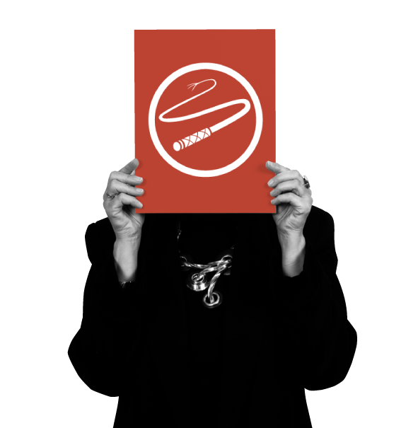
Shaper (SH)
Individual Characteristics | Contribution to the Team
Challenging Driving and dynamic Thrives on pressure Effective delegator | Leads in difficult situations Takes hard decisions Overcomes obstacles
Notes:
Shapers are highly motivated people with a lot of nervous energy, and a great need for achievement. Usually they are assertive (sometimes aggressive) extroverts, and possess strong drive. SHs like to challenge others, and their concern is to win. They like to lead, and to push others into action. If obstacles arise, they will find a way round. Headstrong and assertive, they tend to show strong emotional response to any form of disappointment or frustration.
SHs are single-minded and argumentative, and may lack interpersonal understanding. Theirs is the most competitive team role.
Function:
SHs generally make good managers because they generate action and thrive under pressure. They are excellent at sparkling life into a team, and are very useful in groups where political complications are apt to slow things down. SHs are inclined to rise above problems of this kind, and forge ahead regardless. They are well suited to making necessary changes, and do not mind taking unpopular decisions. As the name implies, they try to impose some shape of pattern on group discussion or activities. They are probably the most effective members of a team in guaranteeing positive action.

Slide 42

Shaper (SH) Weaknesses
Allowable | Non-Allowable
Provocative Aggressive Too task-focused | Inability to recover situation through humor or apology Always think they’re right!

Slide 43

Implementer (IMP)
Individual Characteristics | Contribution to the Team
Disciplined Efficient and organised Reliable | Practical solutions from ideas Follows procedures Turns concept into reality
Notes:
Implementers have practical common sense, and a good deal of self-control and discipline. They favor hard work and tackle problems in a systematic fashion. On a wider front the IMP is typically a person whose loyalty and interest lie with the Company, and who is less concerned with the pursuit of self-interest. However, IMPs may lack spontaneity and show signs of rigidity.
Function:
IMPs are useful to an organization because of their reliability and capacity for application. They succeed because they are efficient, and because they have a sense of what is feasible and relevant. It is said that many executives only do the jobs they wish to do, and neglect those tasks which they find distasteful. By contrast, an IMP will do what needs to be done. Good IMPs often progress to high management positions by virtue of good organizational skills, and competency in tackling necessary tasks.

Slide 44

Implementer (IMP) Weaknesses
Allowable | Non-Allowable
Slow to see possibilities Somewhat inflexible | Obstructs change for no good reason A barrier to progress

Slide 45

Completer Finisher (CF)
Individual Characteristics | Contribution to the Team
Conscientious Attention to detail Delivers results | Perfects existing systems Eradicates errors Crosses the t’s, dots the i’s
Notes:
Completer-Finishers have a great capacity for follow-through and attention to detail. They are unlikely to start anything they cannot finish. They are motivated by internal anxiety, yet outwardly they may appear unruffled. Typically, they are introverted, and require little in the way of external stimulus or incentive. CFs can be intolerant of those with a casual disposition. They are not often keen on delegating, preferring to tackle all tasks themselves.
Function:
CFs are invaluable where tasks demand close concentration and a high degree of accuracy. In management they excel by the high standards to which they aspire, and by their concern for precision, attention to detail and follow-through.

Slide 46

Completer Finisher (CF) Weaknesses
Allowable | Non-Allowable
Anxious Reluctant to delegate | Unreasonably obsessive behavior Produces a Rolls-Royce instead of a Mini

Slide 47

Coordinator (CO)
Individual Characteristics | Contribution to the Team
Strong sense of objectives Promotes decision-making Delegates readily Good chairman | Leads through empowerment Chairs meetings Promotes team contribution
.
Notes:
The distinguishing feature of Co-ordinators is their ability to encourage others to work towards shared goals. Mature, trusting and confident, they delegate readily. In interpersonal relations they are quick to spot individual talents, and to use them in the pursuit of group objectives. While COs are not necessarily the cleverest members of a team, they have a broad and worldly outlook, and generally command respect.
Function:
COs are well placed when put in charge of a team of people with diverse skills and personal characteristics. They perform better in dealing with colleagues of near or equal rank than in directing subordinates. Their motto might well be ‘consultation with control’, and they usually believe in tackling problems calmly. In some organisations COs are inclined to clash with Shapers due to their contrasting management styles.

Slide 48

Coordinator (CO) Weaknesses
Allowable | Non-Allowable
Manipulates within reason Delegates personal workload | Takes credit for the efforts of others Over-reliance on team work

Slide 49

Teamworker (TW)
Individual Characteristics | Contribution to the Team
Cooperative and supportive Diplomatic Averts friction Good listener | Promotes team spirit Builds peer relationships Facilitates communications
Notes:
Team Workers are the most supportive members of a team. They are mild, sociable and concerned about others. They have a great capacity for flexibility, and adapting to different situations and people. TWs are perceptive and diplomatic. They are good listeners, and are generally popular members of a group. They operate with sensitivity at work but they may be indecisive in crunch situations.
Function:
The role of the TW is to prevent interpersonal problems arising within a team, and thus allow all team members to contribute effectively. Not liking friction, they will go to great lengths to avoid it. It is not uncommon for TWs to become senior managers especially if line managers are dominated by Shapers. This creates a climate in which the diplomatic and perceptive skills of a TW become real assets, especially under a managerial regime where conflicts are liable to arise or to be artificially suppressed. TW managers are not seen as a threat, and therefore the most accepted and favored people to work for. Team Workers have a lubricating effect on teams. Morale is better, and people seem to co-operate better when they are around.

Slide 50

Teamworker (TW) Weaknesses
Allowable | Non-Allowable
Indecisive Discourages conflict | Avoids pressure situations No focus on task

Slide 51

Resource Investigator (RI)
Individual Characteristics | Contribution to the Team
Excellent communicator Recognises opportunities Extroverted Enthusiastic | Develops contacts Explores opportunities Negotiates Makes external links
.
Notes:
Resource Investigators are often enthusiastic, quick-off-the-mark extroverts. They are good at communicating with people both inside and outside the company. They are natural negotiators, and are adept at exploring new opportunities and developing contacts. Although not a great source of original ideas, the RI is effective when it comes to picking up other peoples ideas and developing them. As the name suggests, they are skilled at finding out what is available, and what can be done. They usually receive a warm reception from others because of their outgoing nature.
RIs have relaxed personalities with a strong inquisitive sense, and readiness to see the possibilities in anything new. However, unless they remain stimulated by others, their enthusiasm rapidly fades.
Function:
RIs are good at exploring and reporting back on ideas, developments or resources outside the group. They are the best people to set up external contacts, and to carry out any subsequent negotiations.
They have an ability to think on their feet, and to probe others for information

Slide 52

Resource Investigator (RI) Weaknesses
Allowable | Non-Allowable
Can be over-optimistic Loses interest after initial stages | Lets clients down by not following through Too externally focused

Slide 53
Factors Determining Individual Behavior in a Team
Personality
Mental
abilities
Role
learning
BEHAVIOR
Values and
motivations
External
influences
Experience

Slide 54
Team Roles Key Concepts – Individual
Be aware of and manage your Allowable Weaknesses
This is the price to be paid for being good in your preferred roles, e.g., a strong Shaper is going to hurt some peoples feelings as they forge ahead
Ensure that Allowable Weakness does not become “Disallowable”:
Lose a Plant’s attention during a meeting because they are dreaming up a creative solution = OK
Plant forgets to come to meeting because they are thinking about something else = NOT OK!

Slide 55
Team Roles Key Concepts – Individual
Focus on what you do best
Understand and excel in your natural, preferred roles and manage, rather than struggle, to be good at your least-preferred roles

Slide 56




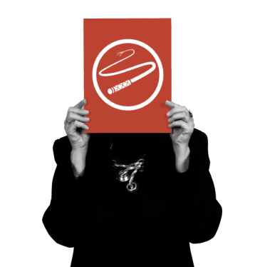




Team Roles Key Concepts – Team
Diversity is essential –
All 9 roles will be needed at some point
Belbin demonstrated that diversity is a key predictor of actual results, it provides a framework for constructive conflict
Doesn’t mean a team needs 9 people (5-6 is typically the ideal)
Each role should be represented within the team
Some roles will be more or less important at a given time or for certain tasks facing the team. Who plays each role may also evolve & change over time.

Slide 57
Team Roles Key Concepts – Team
Beware of having too many of same role on team
Too many Plants – all brainstorming, no action
Too many Monitor Evaluators – analysis paralysis
Too many Shapers – CONFLICT & !!***#%!!/
!$!***#%!#$!/

Slide 58
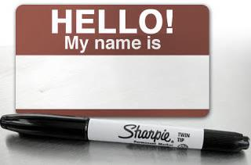
Team Roles Key Concepts – Team
BEWARE OF LABELLING PEOPLE!!
Everyone has 3 to 6 roles that are preferred or manageable - they may need to switch among these different roles based on the circumstances.
Plant
Shaper

Slide 59
How can Belbin Team Roles help you and your team?
Unleashing the potential of each employee by :
Identifying natural talents and attributes
Developing these talents rather than dwell on shortcomings
Wherever possible, realign the job demands with the natural talents.

Slide 60
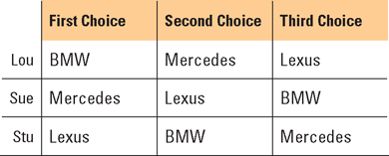
The Voting Paradox: Dictator-By-Default Syndrome Management team is attempting to select a fleet vehicle for its company’s senior executives. Where asked to three choices—BMW, Lexus, and Mercedes, the individual team members reach on an impasse:

